Slide 1
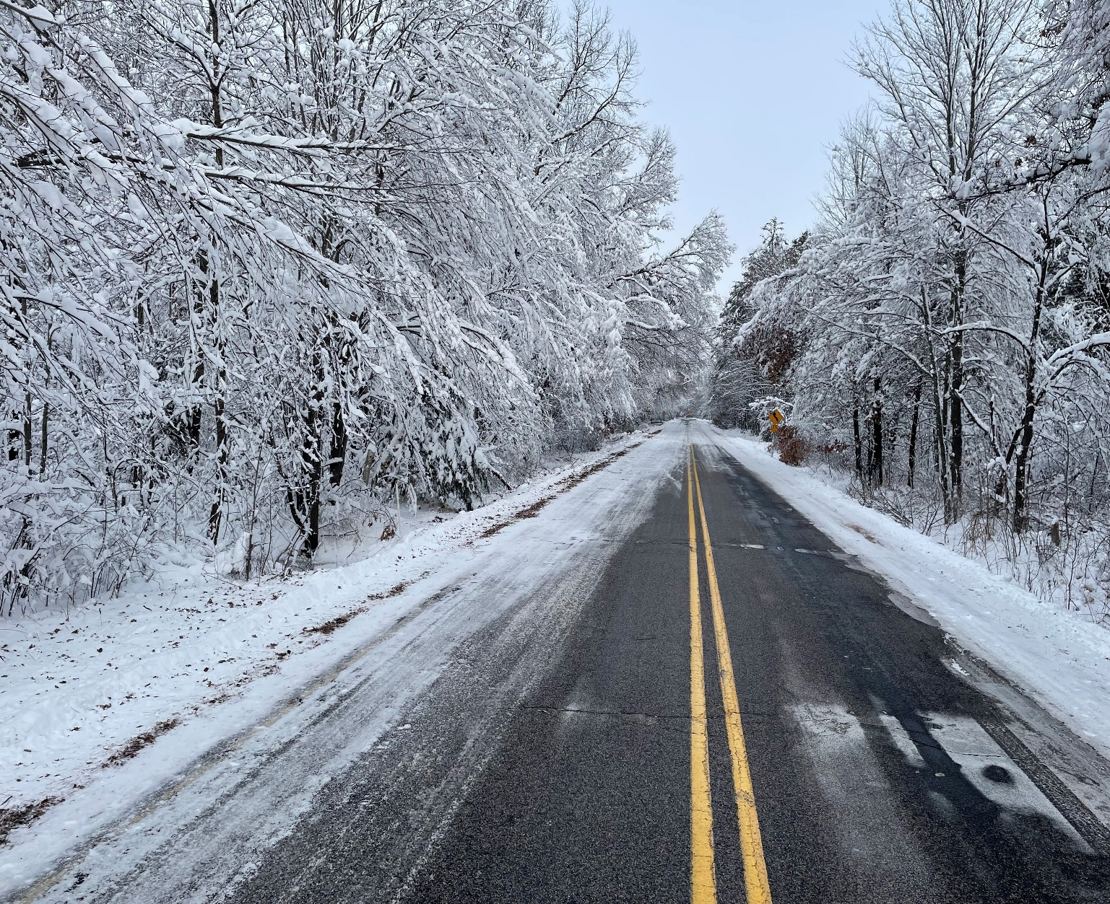
Introductions rOAD AND bRIDGE aID pROGRAMS Shop Services Lunch FEMA Bidding vs. Contracting Directly with the County Pavement Maintenance
february 23, 2023
local roads forum

Slide 2
Introductions rOAD AND bRIDGE aID pROGRAMS Shop Services Lunch FEMA Bidding vs. Contracting Directly with the County Pavement Maintenance
february 23, 2023
local roads forum

Slide 3
Introductions rOAD AND bRIDGE aID pROGRAMS Shop Services Lunch FEMA Bidding vs. Contracting Directly with the County Pavement Maintenance
february 23, 2023
local roads forum

Slide 4
Introductions rOAD AND bRIDGE aID pROGRAMS Shop Services Lunch FEMA Bidding vs. Contracting Directly with the County Pavement Maintenance
february 23, 2023
local roads forum

Slide 5
Introductions rOAD AND bRIDGE aID pROGRAMS Shop Services Lunch FEMA Bidding vs. Contracting Directly with the County Pavement Maintenance
february 23, 2023
local roads forum

Slide 6
Introductions rOAD AND bRIDGE aID pROGRAMS Shop Services Lunch FEMA Bidding vs. Contracting Directly with the County Pavement Maintenance
february 23, 2023
local roads forum

Slide 7
Introductions rOAD AND bRIDGE aID pROGRAMS Shop Services Lunch FEMA Bidding vs. Contracting Directly with the County Pavement Maintenance
february 23, 2023
local roads forum

Slide 8
Introductions rOAD AND bRIDGE aID pROGRAMS Shop Services Lunch EFMA Bidding vs. Contracting Directly with the County Pavement Maintenance
february 23, 2023
local roads forum

Slide 9

Introduction of Highway Dept Staff
Rachel Krause
John Peckham
Brandon Dammann
Randy Kundinger
Engineer
Vacant
Chris
Martin
Roland Hawk
Travis Hofer

Slide 10
John Peckham
Rachel Krause
Travis Hofer
Accounting Supervisor
Program Assistant
Accounting Technician

Slide 11
Brandon Dammann
Randy Kundinger
Chris Martin
Highway Patrol Superintendent
Highway Patrol Superintendent
Shop Supervisor
Vacant
Highway Engineer

Slide 12
Introductions rOAD AND bRIDGE aID pROGRAMS Shop Services Lunch FEMA Bidding vs. Contracting Directly with the County Pavement Maintenance
february 23, 2023
local roads forum

Slide 13
Programs for Municipalities/Towns
County Aid Road & County Aid Bridge 50/50 Program
  Road Aid 50/50 up to amount secured by petition (100% after)
  $5,000 / yr
  Unlimited amount of years to save
  County does the work
  Bridge Aid is 50/50 for entire project costs
  Requires County Commissioner or PE Stamped plan/permits
  No limit to number of Bridge Aid projects
  If petition is filed in advance, billed 50% of cost
  If emergency/late filing petition, billed 100%, refunded 50% following year

Slide 14
Programs for Municipalities/Towns
Local Roads Improvement Program (LRIP)
  LRIP Entitlement – has maximum 50/50 cost share up to cap, 100% after
    Town Road Improvement, TRI
    Municipal Street Improvement, MSI
    County Highway Improvement, CHI
  LRIP Discretionary - has a maximum 50/50 cost share
    TRID, MSID, CHID
  LRIP Supplemental - has a maximum 90/10 cost share
    TRIS, MSIS, CHIS
  Proposed LRIP Bridge (under 20 foot)

Slide 15
Local Programs for Municipalities/Towns
Surface Transportation Program – (STP)
  Rural – STP allocates funds for improvements to federal-aid-eligible rural highway (primarily county & town arterial & major collectors).
  Urban – STP allocates funds to complete improvements to federal-aid-eligible roads, streets and other projects in urban areas.
  Bridge – Federal Aid over 20 foot

Slide 16
Programs for Municipalities/Towns
Local Bridge Assistance Improvement
  Federal Funded
  State Statutes 84.18 and Administrative Rule Trans 213
  Bridge must have 20 foot opening between abutments
  SR<80 for Rehabilitation, SR<50 for Replacement
  County Commissioner establishes priority w/i their county
  Initially 80/20 matching funds
  NEW 100% funded
  Will require Structural Engineer Stamped Plan
  Run through WisDOT Letting Process
  Potential waiver for Rehab Study in March/future BIL Local Bridge Apps

Slide 17
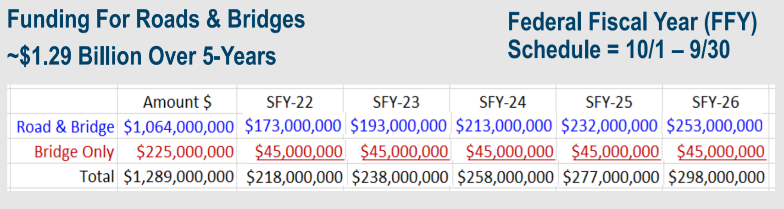
Programs for Municipalities/Towns
  Bipartisan Infrastructure Law (BIL) funding – significant Federal increases into the Surface Transportation Program (STP) over 5 years (FY 22 – FY 26)

Slide 18
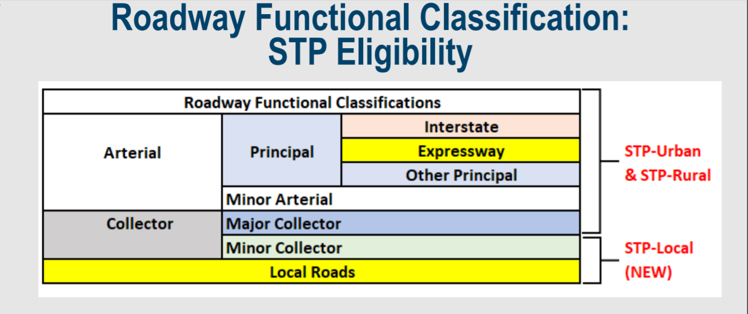
Local Programs for Municipalities/Towns
New Local STP Component
BIL allows WisDOT to allocate a portion of STP funding to adjusted census defined areas with populations of 50K and lower.
May be utilized on roads functionally classified as minor collectors and local roads

Slide 19
Local Programs for Municipalities/Towns
New Local STP Component
BIL allows WisDOT to allocate a portion of STP funding to adjusted census defined areas with populations of 50K and lower.
May be utilized on roads functionally classified as minor collectors and local roads
https://wisdot.maps.arcgis.com/apps/webappviewer/index.html?id=0c12fe578f204941b3b677b118598005

Slide 20
Introductions rOAD AND bRIDGE aID pROGRAMS Shop Services Lunch FEMA Bidding vs. Contracting Directly with the County Pavement Maintenance
february 23, 2023
local roads forum

Slide 21
Consider the Highway Maintenance Shop for your equipment repairs and service!
Chris Martin, Shop Supervisor

Slide 22
Introductions rOAD AND bRIDGE aID pROGRAMS Shop Services Lunch FEMA Bidding vs. Contracting Directly with the County Pavement Maintenance
february 23, 2023
local roads forum

Slide 23
Introductions rOAD AND bRIDGE aID pROGRAMS Shop Services Lunch FEMA Bidding vs. Contracting Directly with the County Pavement Maintenance
february 23, 2023
local roads forum

Slide 24
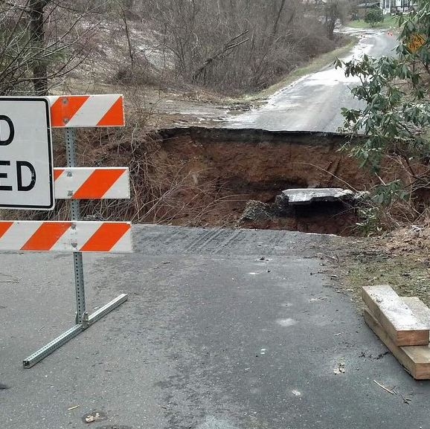
DDA Claims
Bryan Fay
WisDOT Maintenance Engineer
Bryan.Fay@dot.wi.gov
This Photo by Unknown Author is licensed under CC BY

Slide 25
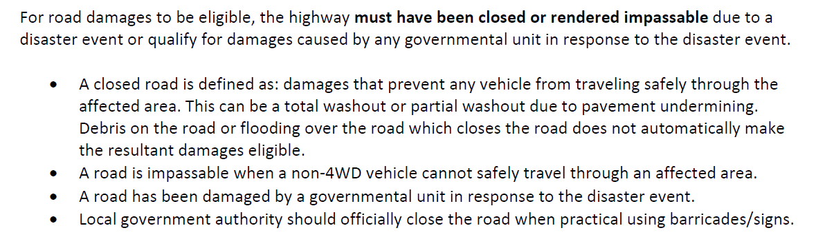
Eligibility

Slide 26
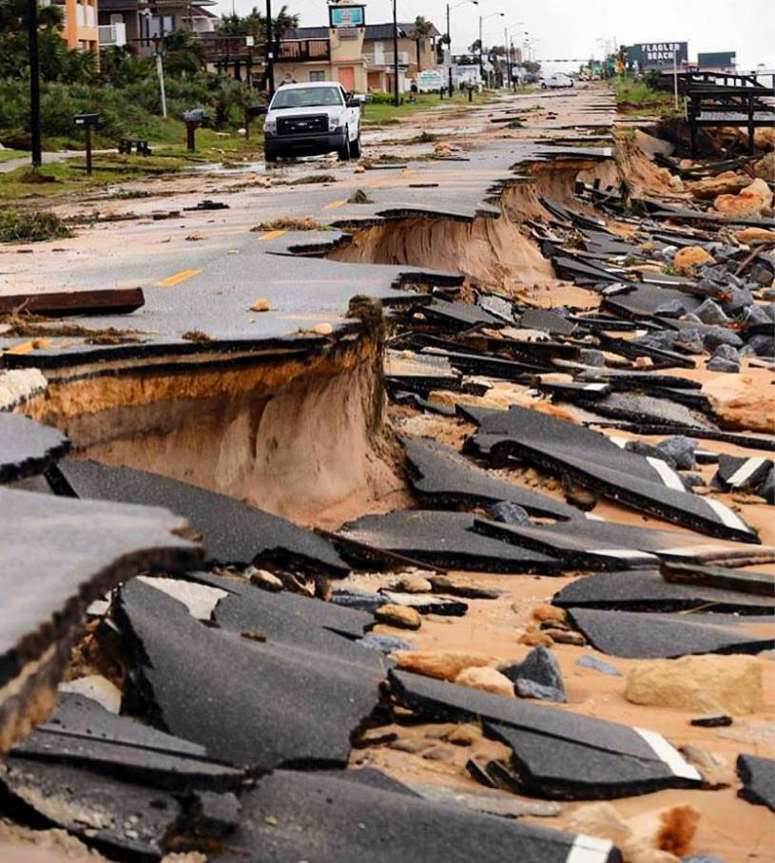
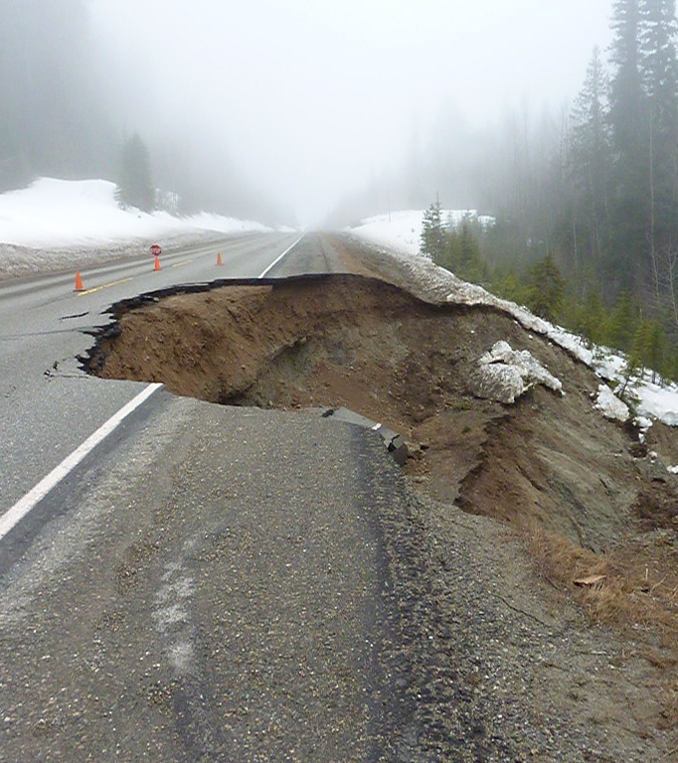
Qualified Roadway
Vs Non Qualified Roadway
This Photo by Unknown Author is licensed under CC BY-NC-ND
This Photo by Unknown Author is licensed under CC BY-NC-ND

Slide 27
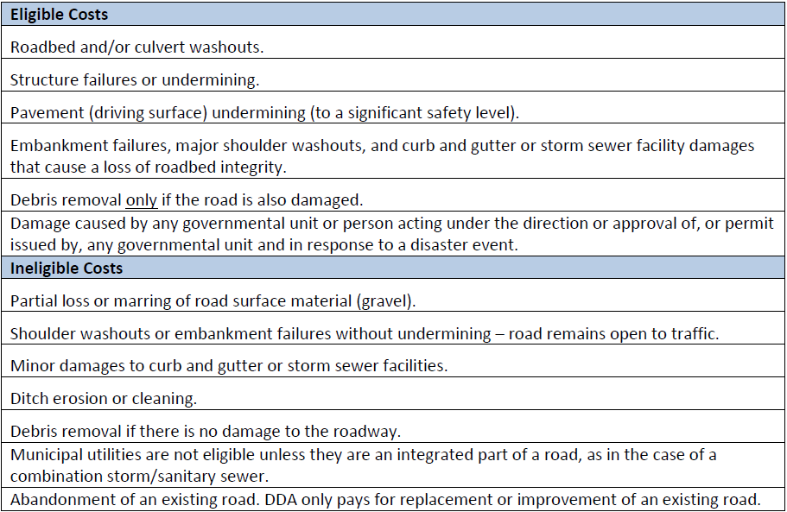
What we pay for

Slide 28
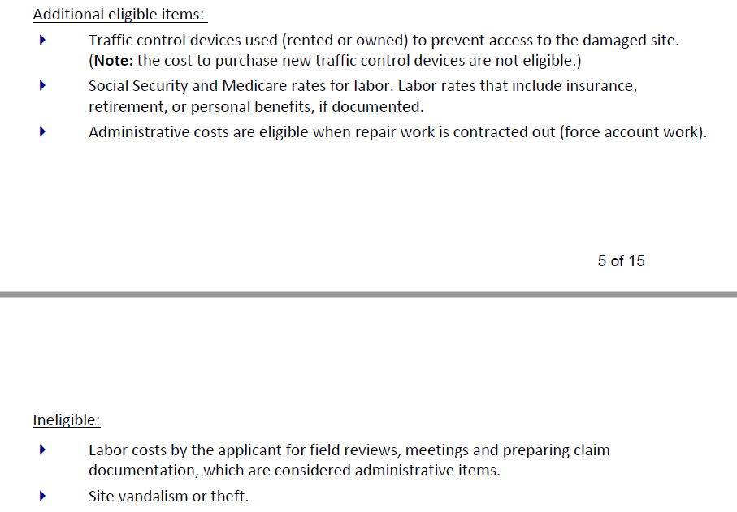
Related Items we would pay for

Slide 29
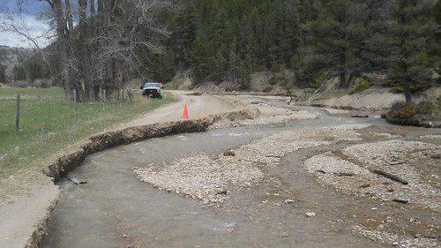
Probably wouldn’t pay for this
This Photo by Unknown Author is licensed under CC BY-SA-NC

Slide 30
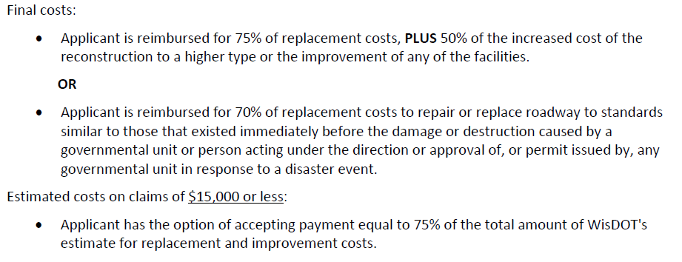
How much we pay for

Slide 31
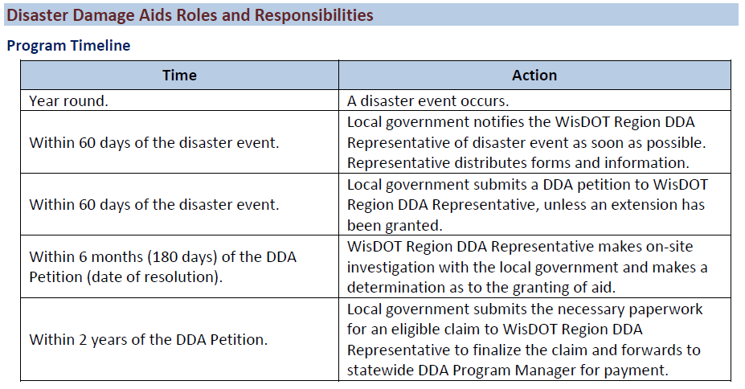
Timeline

Slide 32
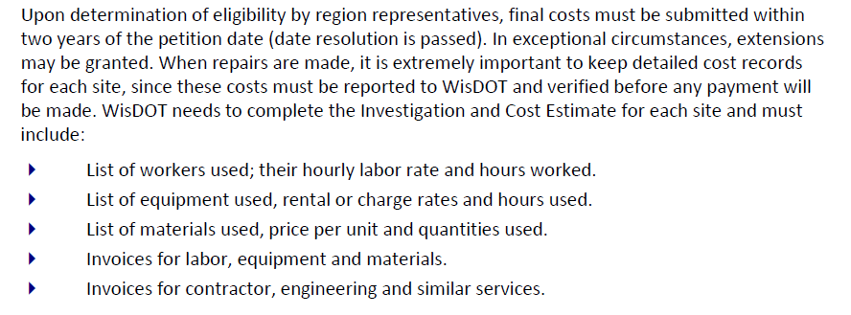
Documentation

Slide 33
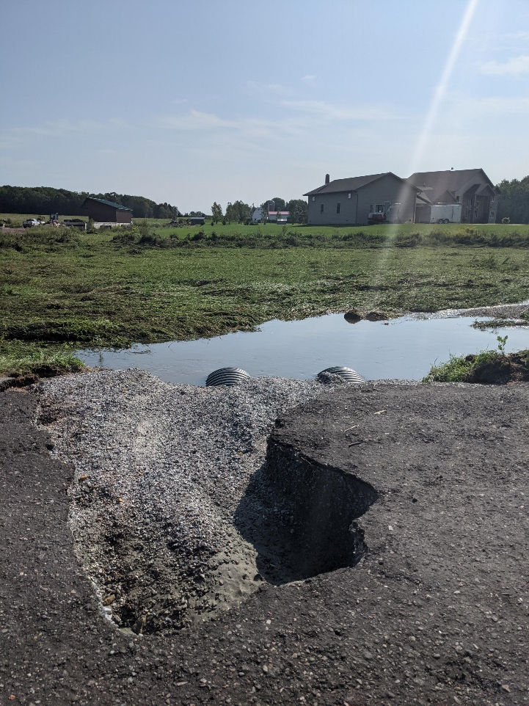

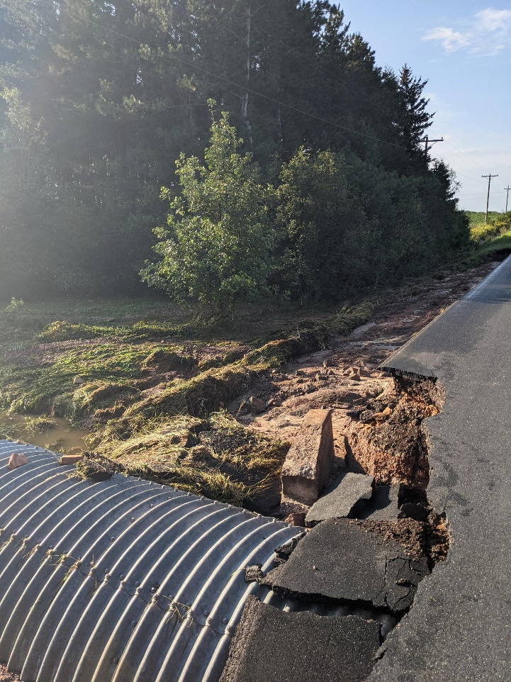
Picture discussion

Slide 34
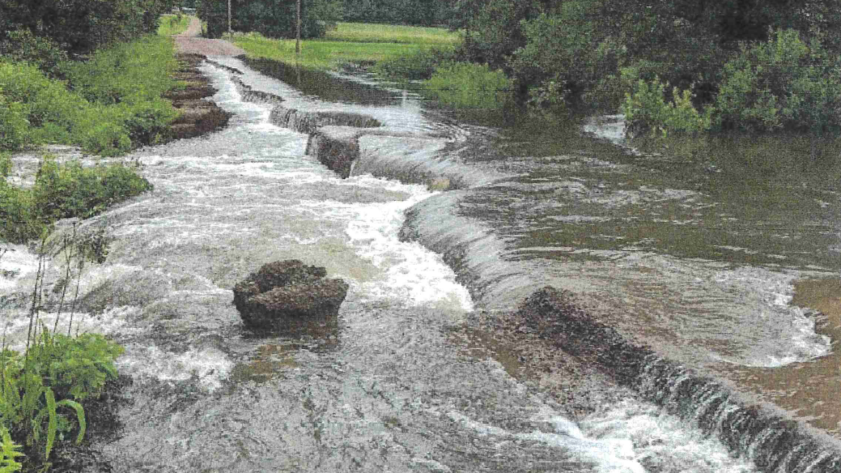

Slide 35
Wrap up/Questions/Comments
Road needs to be impassible
Pictures, pictures, pictures
Process Takes time
Bryan Fay, WisDOT Maintenance Engineer
Bryan.Fay@dot.wi.gov ; 715-499-1926

Slide 36
Introductions rOAD AND bRIDGE aID pROGRAMS Shop Services Lunch EFMA Bidding vs. Contracting Directly with the County Pavement Maintenance
february 23, 2023
local roads forum

Slide 37
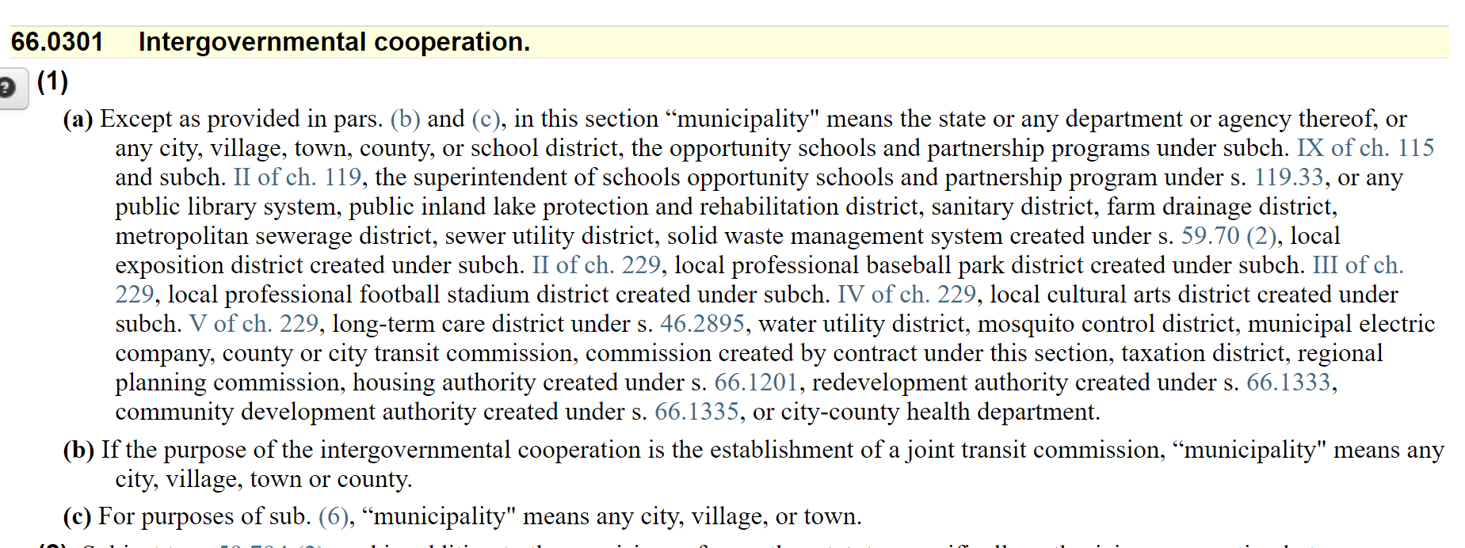
Bidding vs Contracting with Highway Dept.
State Statutes, CHAPTER 66 GENERAL MUNICIPALITY LAW

Slide 38
Bidding vs Contracting with Highway Dept.
State Statutes, CHAPTER 66 GENERAL MUNICIPALITY LAW
66.0301 Intergovernmental cooperation.
(1)
(a) Except as provided in pars. (b) and (c), in this section “municipality" means the state or any department or agency thereof, or any city, village, town, county, or school district, the opportunity schools and partnership programs under subch. IX of ch. 115 and subch. II of ch. 119, the superintendent of schools opportunity schools and partnership program under s. 119.33, or any public library system, public inland lake protection and rehabilitation district, sanitary district, farm drainage district, metropolitan sewerage district, sewer utility district, solid waste management system created under s. 59.70 (2), local exposition district created under subch. II of ch. 229, local professional baseball park district created under subch. III of ch. 229, local professional football stadium district created under subch. IV of ch. 229, local cultural arts district created under subch. V of ch. 229, long-term care district under s. 46.2895, water utility district, mosquito control district, municipal electric company, county or city transit commission, commission created by contract under this section, taxation district, regional planning commission, housing authority created under s. 66.1201, redevelopment authority created under s. 66.1333, community development authority created under s. 66.1335, or city-county health department.
(b) If the purpose of the intergovernmental cooperation is the establishment of a joint transit commission, “municipality" means any city, village, town or county.
(c) For purposes of sub. (6), “municipality" means any city, village, or town.

Slide 39
(2) Subject to s. 59.794 (2), and in addition to the provisions of any other statutes specifically authorizing cooperation between municipalities, unless those statutes specifically exclude action under this section, any municipality may contract with other municipalities and with federally recognized Indian tribes and bands in this state, for the receipt or furnishing of services or the joint exercise of any power or duty required or authorized by law. If municipal or tribal parties to a contract have varying powers or duties under the law, each may act under the contract to the extent of its lawful powers and duties. A contract under this subsection may bind the contracting parties for the length of time specified in the contract. This section shall be interpreted liberally in favor of cooperative action between municipalities and between municipalities and Indian tribes and bands in this state. If a municipality is required to establish or maintain an agency, department, commission, or any other office or position to carry out a municipal responsibility, and the municipality joins with another municipality by entering into an intergovernmental cooperation contract under this subsection to jointly carry out the responsibility, the jointly established or maintained agency, department, commission, or any other office or position to which the contract applies fulfills, subject to sub. (7), the municipality's obligation to establish or maintain such entities or positions until the contract entered into under this subsection expires or is terminated by the parties. In addition, if 2 or more municipalities enter into an intergovernmental cooperation contract and create a commission under this section to jointly or regionally administer a function or project, the commission shall be considered, subject to sub. (7), to be a single entity that represents, and may act on behalf of, the joint interests of the signatories to the contract entered into under this section.

Slide 40
60.47 Public contracts and competitive bidding.
(1) Definitions. In this section:
(a) “Public contract" means a contract for the construction, execution, repair, remodeling or improvement of any public work or building or for the furnishing of materials or supplies, with an estimated cost greater than $5,000.
(b) “Responsible bidder" means a person who, in the judgment of the town board, is financially responsible and has the capacity and competence to faithfully and responsibly comply with the terms of the public contract.
(2) Notice; advertisement for bids. Except as provided in subs. (4) and (5):
(a) No town may enter into a public contract with an estimated cost of more than $5,000 but not more than $25,000 unless the town board, or a town official or employee designated by the town board, gives a class 1 notice under ch. 985 before execution of that public contract.
(b) No town may enter into a public contract with a value of more than $25,000 unless the town board, or a town official or employee designated by the town board, advertises for proposals to perform the terms of the public contract by publishing a class 2 notice under ch. 985. The town board may provide for additional means of advertising for bids.

Slide 41
60.47 Public contracts and competitive bidding.
(3) Contracts to lowest responsible bidder. The town board shall let a public contract for which advertising for proposals is required under sub. (2) (b) to the lowest responsible bidder. Section 66.0901 applies to public contracts let under sub. (2) (b).
(4) Contracts with governmental entities. This section does not apply to public contracts entered into by a town with a municipality, as defined under s. 66.0301 (1) (a).
(5) Exception for emergencies and donated materials and labor. This section is optional with respect to public contracts for the repair and construction of public facilities when damage or threatened damage to the facility creates an emergency, as declared by resolution of the town board, that endangers the public health or welfare of the town. This subsection no longer applies when the town board declares that the emergency no longer exists. This section is optional with respect to a public contract if the materials related to the contract are donated or if the labor that is necessary to execute the public contract is provided by volunteers.

Slide 42
66.0301 Intergovernmental cooperation.
(1)
(a) Except as provided in pars. (b) and (c), in this section “municipality" means the state or any department or agency thereof, or any city, village, town, county, or school district, the opportunity schools and partnership programs

Slide 43
Bidding vs Contracting Questions
?

Slide 44
Introductions rOAD AND bRIDGE aID pROGRAMS Shop Services Lunch EFMA Bidding vs. Contracting Directly with the County Pavement Maintenance
february 23, 2023
local roads forum

Slide 45
Consider the Highway Services and Experience for your pavement and R/W Maintenance!
Brandon Dammann & Randy Kundinger, Patrol Supervisors

Slide 46
ANY Questions
?

Slide 47
THANK YOU!
?

